Slide 1


HEART DISEASE PREDICTION USING MACHINE LEARNING
MAHAVEER INSTITUTE OF SCIENCE AND TECHNOLOGY
SEMINAR ON
SUGGESTED BY: PRESENTED BY:
SIDDI SRINIVAS SIR YASMEEN BEGUM
K.HIMA BINDU

Slide 2

ABSTRACT
Heart related diseases are the main reason for a huge number of death in the world
So, there is a need of reliable, accurate and feasible system to diagnose such diseases in time for proper treatment
Machine Learning algorithms and techniques have been applied to various medical datasets to automate the analysis of complex data.
Many researchers have been using several machine learning techniques to help the health care industry in the diagnosis of heart related diseases
Keywords:SVM,KNN,Naives Bayes, Decision Trees (DT), Random Forest (RF)

Slide 3

CONTENTS
INTRODUCTION
EXISTING SYSTEM
PROPOSED SYSTEM
MODULES
HARDWARE REQUIREMENTS
SOFTWARE REQUIREMENTS
CONCLUSION

Slide 4

INTRODUCTION
Cardiovascular disease is one of the most fatal condition in the present world
By utilising the patient medical record as a dataset it will predict the heart disease.
Attributes such as Age,Blood pressure, Thickness of artery etc.
By using Machine Learning algorithms it will predict the result of heart disease

Slide 5

EXISTING SYSTEM
Heart disease is even being highlighted as silent killer which leads to death of a person without obvious symptoms
Very few systems use the available clinical data for prediction purpose.
Diagnosis of a condition solely depends upon the doctors intitution and patients records.
Practical use of various collected data is time consuming.

Slide 6

PROPOSED SYSTEM
Dimensionality Reduction involves selecting a mathematical representation of data.
The data considered for a task or a problem, may consists of a lot of attributesor dimensions.
A large number of attributes, or features, may affect the computational complexity .
Thus, Dimensionality Reduction is a very important step considered while building any model.

Slide 7
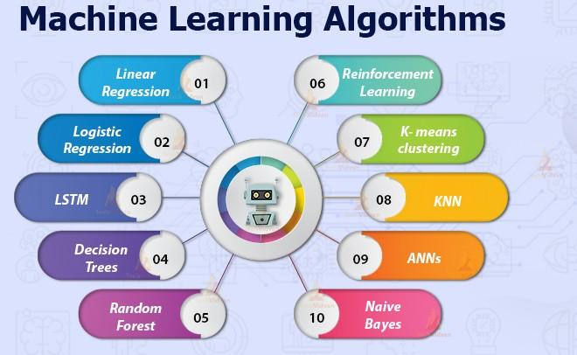
MODULES
Naïve Bayes
Support Vector Machine
K – Nearest Neighbour
Decision Tree
Random Forest

Slide 8

Processor: Pentium IV or higher
RAM: 256 MB
Space on Hard Disk: minimum 512MB
HARDWARE REQUIREMENTS

Slide 9




SOFTWARE REQUIREMENTS
Python
Django
Mysql
Wampserver
Operating system:Windows

Slide 10

CONCLUSION
With the increasing number of deaths due to heart diseases,it has become mandatory to develop a system to predict heart diseases effectively and accurately.
The motivation for the study was to find the most efficient ML algorithm for detection of heart diseases.
This study compares the accuracy score of Decision Tree, K-Nearest Neighbour, Random Forest and Naive Bayes algorithms for predicting heart disease using dataset.
This analysis provide better results and help health professionals in predicting the heart disease effectively and efficiently.

Slide 11




